Slide 1
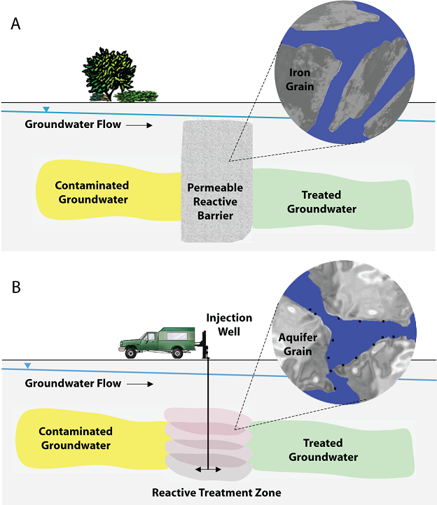
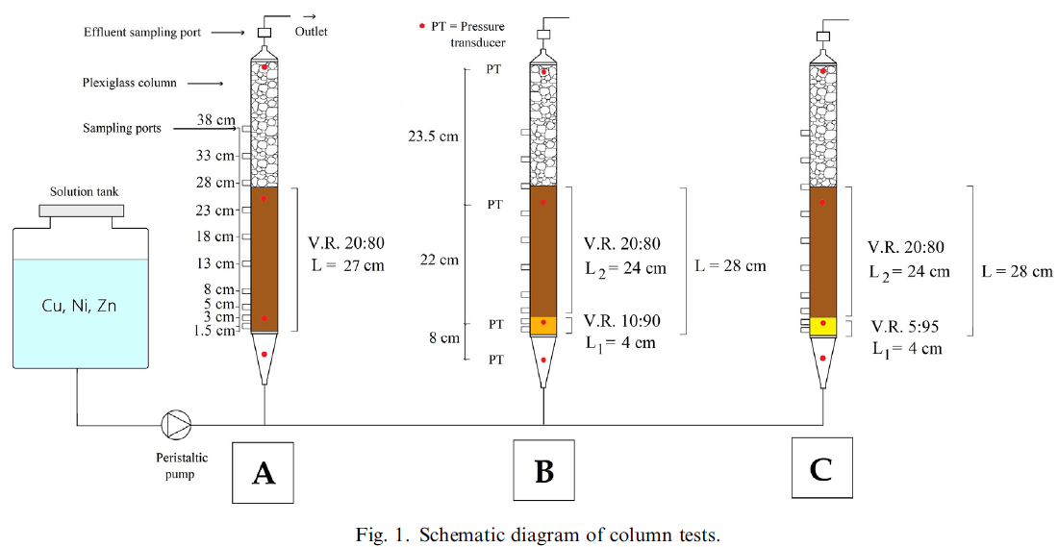
Soils and Foundations 63 (2023) 101398 https://doi.org/10.1016/j.sandf.2023.101398
Behavior of multi-layer permeable reactive barriers for groundwater remediation
Stefania Bilardi, Silvia Simonetti, Paolo Salvatore Calabro, Nicola Moraci
[Objective] Permeable reactive barrier (PRB): Barrier of groundwater contamination.
Evaluate the efficiency of a multilayer configuration of a PRB made up of granular mixtures of zero valent iron (ZVI) and lapillus. A high dispersion of ZVI improves the long-term k but can reduce reactivity due to the lower amount of ZVI.
[Methods]
Performance of 2 different combinations of a two-layer configuration was studied by means of long-term column tests.
The first layer, named ‘‘pre-treatment layer”, had a thickness of 4 cm and a volumetric ratio (ZVI/lapillus) of 10:90 or 05:95, while the second layer had a volumetric ratio (ZVI/lapillus) of 20:80.
A single layer configuration made only of the 20:80 ZVI/lapillus was used as a benchmark. The three tests were performed using a multi-contaminated solution of copper, nickel and zinc.
[Results]
Test results showed an early loss of the k in the single layer configuration and an increase of PRB longevity by 68 % in the presence of the pre-treatment layer.
The pre-treatment zone containing 10 % ZVI delayed the clogging phenomenon, while the zone with 5 % ZVI ensured both the correct long-term hydraulic behavior and a removal efficiency higher than 77.6 % for Nickel and 99 % for copper and zinc at 23 cm of thickness for at least two months.

Slide 2
Soils and Foundations 63 (2023) 101392 https://doi.org/10.1016/j.sandf.2023.101392
Constitutive modeling and analysis of geomaterials Fusao Oka
Review paper of experimental and theoretical aspects of geomechanics, namely, the constitutive modeling of cohesive and sandy soils, the governing equations of three-phase materials, and analyses of the behavior of geomaterials and grounds.
The following topics are included in the papers: effective stress, skeleton stress, constitutive models of clayey and sandy soils and soft rocks, material instability, strain localization, consolidation, bearing capacity, excavation problems, governing equations of multi-phase geomaterials, liquefaction, unsaturated soil, seepage-deformation coupled analysis, gas hydrate-contained soil, internal erosion, the material point method (MPM), and X-ray CT for geomaterials.
The content of this review article can be divided into three categories: constitutive models, analysis methods including governing equations for multi-phase soil, and applications of geomaterials. For clay soils, elasto-visco-plastic models, cyclic inelastic models, and strain-softening models were proposed. For sandy soils, a cyclic elastoplastic model was proposed, adopting the nonlinear kinematic hardening theory. Additionally, governing equations for two-phase and three-phase geomaterials were proposed, leading to the development of numerical analysis methods for multi-phase soil. This enabled precise analyses of unsaturated soil grounds. Various problems related to soil deformation were numerically resolved, and numerous experimental studies were also conducted. These studies included observations of the anisotropic behavior of clay and the characteristics of unsaturated sandy soils.

Slide 3
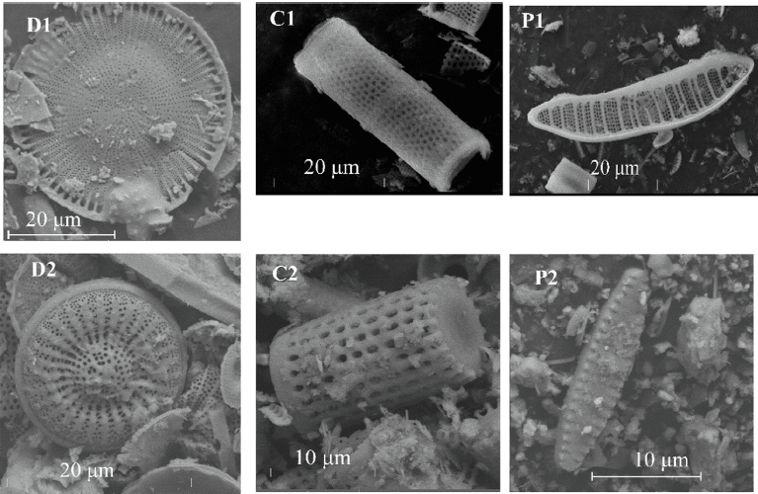
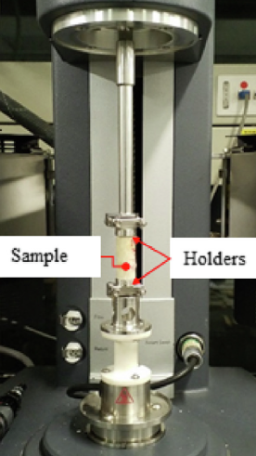
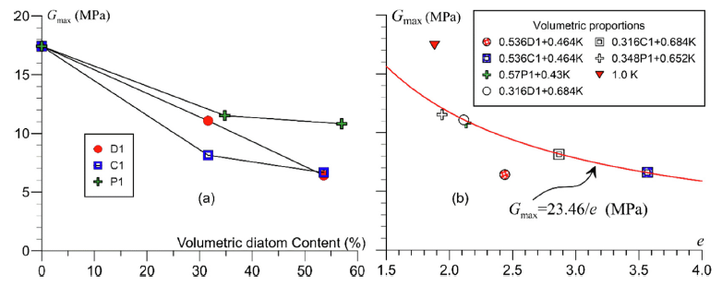
Soils and Foundations 63 (2023) 101374 https://doi.org/10.1016/j.sandf.2023.101374
Effect of the particle’s shape on the dynamic shear modulus and compressibility of diatomaceous soils
Laura Ibagon, Bernardo Caicedo, Juan P. Villacreses, Fabricio Yepez
[Outline]
one of the reasons for the low degradation of the shear modulus and the strong amplification that undergoes the Mexico City basin is the presence of diatoms that also increases the compressibility.
Diatom’s shape effect on diatomaceous soil mixtures’ dynamic and compressibility properties.
Physical characteristics of six diatomite samples with variable shapes and taxonomies are presented.
[Method]
Among these six samples, 3 diatomites of similar grain size distribution were mixed with kaolin, and the mechanical properties (i.e., shear modulus and damping ratio from small to large strains) were analysed.
[Results]
Diatom frustules increased compressibility and reduced maximum shear modulus.
Diatom’s shape influenced shear modulus degradation curve and damping ratio.
Diatomites reduces the energy dissipation capacity in soils.

Slide 4
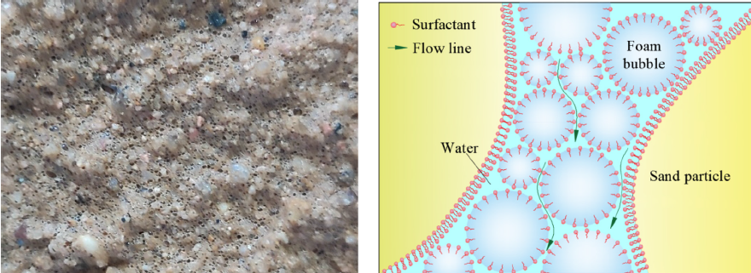
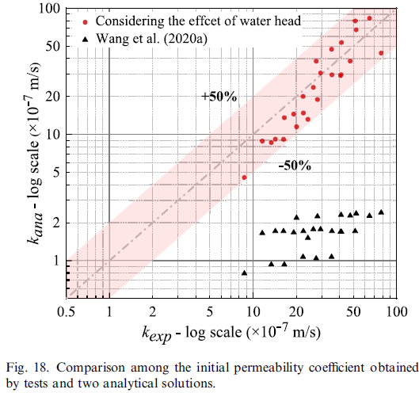
Soils and Foundations 63 (2023) 101404 https://doi.org/10.1016/j.sandf.2023.101404
Effect of water head on the permeability of foam-conditioned sands: Experimental and analytical investigation
Shuying Wang, Zhiyao Feng, Tongming Qu, Shuo Huang, Xiangcou Zheng
[Background]
EPB shield machines are good for tunneling.
In high k sand below the water level, water spewing causing hard to control.
Foam is injected into the soil chamber to reduce k of excavated soils.
However, h effect on the k of foam-conditioned sands are still unclear.
[Method]
large-scale k tests with various d10,s and FIRs.
→ New analytical model to estimate the initial k of foam-conditioned sands.
[Results]
Initial k increases with the h, and its initial stable period becomes shorter. It is observed that there is no initial stable period for foam-conditioned sands under a relatively high-h.
With an increase in d_{10,s}, the k of foam-conditioned sand become more sensitive to h and changing extent of initial stable period duration reduces.
Initial k of foam-conditioned sands calculated by analytical method match quite well with experimental results, and it indicates great suitability of proposed calculation model.

Slide 5
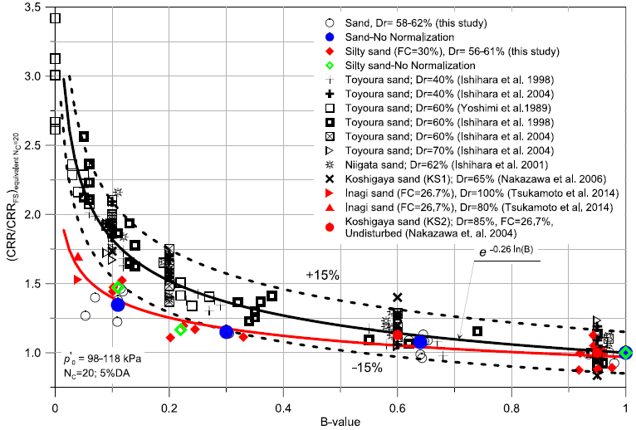
Soils and Foundations 63 (2023) 101400 https://doi.org/10.1016/j.sandf.2023.101400
Effects of partial saturation on the liquefaction resistance of sand and silty sand from Christchurch
Md Abdul Lahil Baki, Misko Cubrinovski, Mark Edward Stringer, Sjoerd van Ballegooy, Nikolaos Ntritsos
[Background]
2010–2011 Canterbury earthquakes, widespread liquefaction occurred.
Despite the uniformly high seismic demand in the affected areas, a wide range of liquefaction performances were observed, ranging from severe to no liquefaction manifestation.
[Method]
Liquefaction resistance of partially saturated soil was experimented for sand & silt of Christchurch.
Cyclic undrained tests on fully / partially saturated sand / silt, with evaluation of saturation conditions in situ field Vp.
Skempton’s B-value & Vp were used as measures for partial saturation.
[Results]
B-value & Vp relationships: Vp ∝ B-value (until a full saturation)
1/Liquefaction resistance ∝ Vp, B-value.
Threshold B-values and Vp are exist (dependent on soil type and confining stress).
Sand: Vp ↓ → liquefaction resistance gradually ↑.
Silt: Vp ↓ → liquefaction resistance gradually ↑ first, and rapidly ↑.
Good agreement between liquefaction strength of tested soils and published data was observed, with a clear distinctive feature in the behavior of the silty sand as compared to clean sands.
Fig. 18. Liquefaction strength of different soils against B-value (data points obtained following equivalent approach where applicable).

Slide 6
Soils and Foundations 63 (2023) 101380 https://doi.org/10.1016/j.sandf.2023.101380
Improved support point selection on adaptive kriging metamodels for reliability analysis of soil slopes
C. Arevalo, R.O. Ruiz, Y. Alberto

Slide 7
Soils and Foundations 63 (2023) 101382 https://doi.org/10.1016/j.sandf.2023.101382
Influence of different axis-translation techniques using ceramic disks and microporous membrane filters on mechanical and hydraulic behavior of unsaturated soil Junnan Maa, Xi Xiong, Feng Zhang
[Background]
The mechanical behavior of unsaturated soil is of major concern and differs greatly from that of saturated soil.
Discrepancies shown in unsaturated test results using axis-translation techniques (ATTs) with ceramic disks & microporous membrane filters (MM filters).
This indicated that misunderstandings perceived elementary behavior seen in element tests.
[Method]
In this study, triaxial tests with ceramic disks and MM filters were firstly conducted on specimens of unsaturated completely decomposed granite sand to compare the influence of different techniques on the test results.
Then a soil–water–air coupled FE-FD method, based on a newly proposed unsaturated/saturated constitutive model coupled with a deformation-dependent water retention curve (WRC), was utilized to simulate triaxial tests as boundary value problems (BVPs) because of the non-uniform deformation of the specimens.
[Results]
1. Ceramic disks or MM filters → little difference in 𝜎-𝜀 relations, but significant differences in saturation ratio (Sr) changes.
2. FE-FD calculation → good agreement. deformation parameter (c_{e}), affecting of hydraulic-mechanical behavior accuracy.
3. Ceramic disks exhibited higher overall suction than MM filters, leading to more drainage during shearing.
4. Main problem is boundary value problems (BVPs).

